Slide 1






INNOVATIONS FOR EXPORTS
IN UKRAINE
2018-2020

Slide 2



# Cross-sector Overview
500 000+
construction, manufacturing,
engineering students
2 000+ startups
150 000+ patents and
utilities issued in Ukraine
since 2007
Big number of
technical universities
100+ R&D centers
60+ cluster organizations
Around 40 industrial parks
38
commercialization centers
32
science parks
26 centers of innovation
and technology transfer
24 innovative
business incubators
22
innovation centers
16
technology parks
$510 mln investments
in Ukrainian IT companies

Slide 3


# Ukraine in Global Rankings
Ranked 45th by 2020’s
Global Innovation Index among 131 countries
23rd in Knowledge creation sub-index
32nd in Knowledge diffusion sub-index
45th in Knowledge impact sub-index
23rd in Education sub-index
32nd in Tertiary education sub-index
44th in Research & Development (R&D)
sub-index
23rd in Intangible assets sub-index
39th in Online creativity sub-index
28th by World Design
Ranking 2019
among 106 countries
29th by StartupBlink
global ranking 2020 based
on evaluation of Startup
ecosystem
60th by 2019’s
WEF Global Competitiveness
Index Innovation Ranking
among 140 countries
Gradually improving
in the Doing Business
Ranking

Slide 4

# Why Ukraine?
Qualified and
recognized
production
services
Reliable
trade
partner
Developed
innovations
International and
EU standards
Significant market
capacity
Strong
skills and competences
Historically
strong tech
education
State
digitalization
program
Qualified
human
capital

Slide 5

# Ukraine’s Innovation Ecosystem
Financial
Instruments
Venture
Capital
Entrepreneurs
Corporations
R&D Universities
Government Policy
Service Providers
Experienced Managers

Slide 6
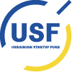


# Ukraine’s Innovation Ecosystem
The Ukrainian Startup Fund is a national investment program that supports innovations in Ukraine by funding the most talented Ukrainian entrepreneurs.
Innovation and Development Foundation is an international solutions platform designing innovative mechanisms for accumulation, acceleration, and transfer of expertise aimed at state sector reforming, business consulting and civil societies support.
Private Joint Stock Company Export Credit Agency aims at facilitating Ukrainian exports.

Slide 7









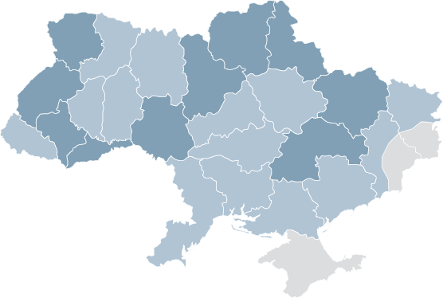













# Major Cluster Organizations
Precarpathian
eco-energy
cluster

Slide 8
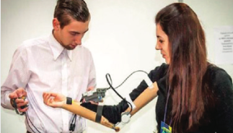



# Ukrainian Innovative Products
ROBOTIC TECHNOLOGIES
UniExo is a high tech company, that creates modular exoskeletons using machine learning algorithms and doctor online-surveillance. These devices reduce recovery period caused by injuries by assisting and supporting patients outside the healthcare facilities. Personalized physical rehabilitation solution can help regain and encourage limb mobility of patients.
SolarGaps - external aluminum Venetian blinds with solar panels, which generate electricity. Smart blinds automatically track the sun and generate green energy.
It can be used as an alarm clock in the morning and preserve your privacy during the night. SolarGaps protect house from external influences, shade the room, and ensure saving up to 30% on air conditioning.

Slide 9



# Ukrainian Innovative Products
SMART OASIS is a unique, fully autonomous modular system designed for independent zero-carbon water production. 3 product lines: city – fully autonomous water fountains that produce 55 litres of drinking water per day with zero-waste; smart farming – a fully autonomous greenhouse that can grow 3000 kg of greens per year even in the middle of the desert with no access to water and other utilities; solar – autonomous cleansing distilled water modules that increase productivity of the solar park by 25% and cut expenses on human labour.
This is the first interactive, multi-touch table that can be used in public spaces such as restaurants due to its durability - technology recognizes touches through up to 20 mm of glass. Every visitor can touch the table surface to order menu items and services, as well as play games.

Slide 10



# Ukrainian Innovative Products
PassivDom is a housing solution for cold and hot climates. PassiveDom houses are solar-powered and have zero carbon emission. The autonomous house can operate itself and make own decisions. Houses are equipped with 6 glazed windows with infrared absorption and thermal energy storage.
For more details please refer to Ukrainian Innovative Products brochures:

Slide 11
# Cross-sector Export Strategy
Innovations For Exports
Vision
A creative economy for innovative, competitive and value-added exports

Slide 12





# Cross-sector Export Strategy
Innovations For Exports
Strategic Objectives
Strengthen the Ukrainian
innovation ecosystem and support the business environment to boost innovation and entrepreneurship activity and grow exports
Strengthen linkages between science and academia, business and government both within the ecosystem and beyond
Improve the business, regulatory and policy environment to facilitate innovations
Connect Ukrainian innovation ecosystem internationally to facilitate partnerships, business linkages and investments into innovations
Develop financial and support services for enterprises and innovators to rapidly develop
and scale-up innovative and value-added exportable products and services
Provide Ukrainian innovators and entrepreneurs with easy-to-access financial instruments for each and every stage of their innovation activity
Develop extensive state-of-the-art tech infrastructure allowing to rapidly prototype and produce innovative products for exports
Provide specific support instruments to enhance innovations in the ESU priority sectors
Develop skills and competencies
of Ukraine’s entrepreneurs, managers, scientists, innovators and enterprises to design and commercialise innovations internationally
Develop education and training efforts with a focus on innovation management and entrepreneurship to ensure successful exports of innovative products and services
Upgrade skills of managers, innovators, scientists and people who deal with innovations within private and public enterprises

Slide 13
Thank you for attention!

