Slide 1






TRADE INFORMATION AND
EXPORT PROMOTION
IN UKRAINE
2018-2020

Slide 2





# Export of Goods
Export of goods $ 22 912 571,4k
Ukrainian products are exported to 160 countries
TOP 5 exported products
Key export destinations
Products of plant origin
$ 5 725 985,1k
Base metals and manufactures
$ 5 291 352,1k
Animal or vegetable fats and oils
$ 3 427 493,2k
Mineral products
$ 2 801 375,5k
Machinery and equipment
$ 2 362 318,8k
EU countries
China
Turkey
Egypt
India
Belarus
USA
$ 8 525 672,9k
$ 3 005 244,6k
$ 1 176 620,2k
$ 969 888,8k
$ 870 417,7k
$ 644 622,9k
$ 444 535,9

Slide 3



# Export of Services
Export of services $ 5 370 853,4k
Ukrainian services are exported to 156 countries
TOP 5 exported services
Key export destinations
Transport services
$ 2 337 894,3k
Telecommunications, computer
and information services
$ 1 401 959,8k
Processing of material resources
$ 671 660,3k
Business services
$555 266,9k
Travel services
$ 128 020,1k
$ 2 011 046,4k
$ 663 718,5k
$ 402 040,6k
$ 152 511,2k
$ 1 266 564,2k
$ 98 290,9k
EU countries
USA
Switzerland
UAE
Russia
Israel

Slide 4

# Why Ukraine?
PPP possibilities,
including
concessions
Favourable
geographical
location
Human
capital
Developed
infrastructure
SMEs
support
Investment
attraction
Labour
market
development
Strong
institutional
support
Part of
TNT
Adequate
legislation
Range of
Free Trade
Agreements
Trade
facilitation
Innovations
Reasonable
regulatory
framework

Slide 5





# Ukraine in Global Rankings
20th in Global
Services Location
Index 2019 by
45th by
51st by
World’s
Top Export
Countries
ranking 2019
Gradually improving
in the Doing Business ranking
– B+
– B
Export Promotion Office of Ukraine is EEPA 2020 National
Winner in Supporting the Internationalisation of Business
won SABRE Awards
EMEA 2020

Slide 6
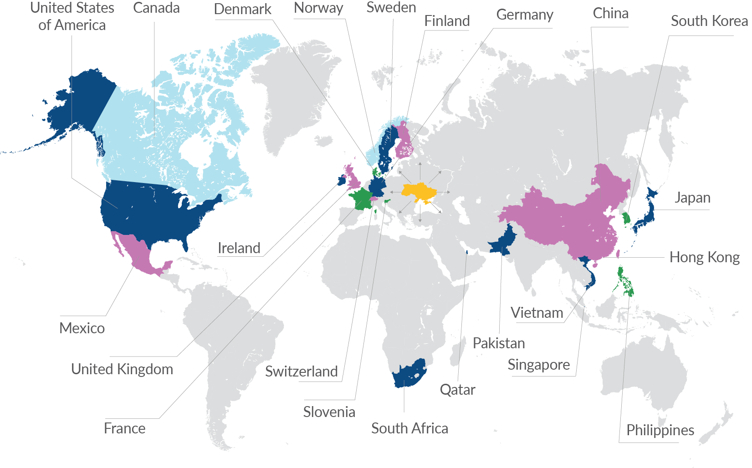
# Markets in Focus

Slide 7

# Priority Sectors under the
Export Strategy of Ukraine
TOP
export destinations
Value of
export
USA
EU
Canada
No1 in Europe by the volume of IT services
2nd largest services exporter in Ukraine in 2019
100+ Fortune 500 companies are Ukrainian IT companies’ clients
$ 2,43 bln
EU
China
Egypt
44.2% of total export in 2019. Sector products are exported to 190 countries
Leading products:
1. Sunflower oil, sunflower meal
2. Rapeseed
3. Walnuts
$ 2,43 bln
EU
China
Russia
Ukraine’s export-oriented machinery subsectors:
electric and electronic appliances
agricultural machinery and equipment, including forestry
aircraft and spacecraft, related equipment
telecommunications equipment
$ 2,43 bln

Slide 8

# Priority Sectors under the
Export Strategy of Ukraine
TOP
export destinations
Value of
export
EU
USA
Israel
TOP-25 most awarded countries by Cannes Lions in 2019
29 Red Dot Awards in 2018-2019
12 Ukrainian audiovisual products presented at A listed film festivals around the globe in 2019
25 + 5% cash rebate for qualified expenses
$ 1,3 bln
India
Algeria
EU
Leading Ukraine’s aircraft repair and maintenance sector customers,
whose share increased in 2018
USA
$ +5,6 mln
India
$ +2,9 mln
Republic of Korea
$ +2,4 mln
Bangladesh
$ +1,7 mln
Ethiopia
$ +1,6 mln
Egypt
$ +1,5 mln
British Virgin Islands
$ +1,4 mln
Peru
$ +1,3 mln
Uzbekistan
$ +1,1 mln
Around
$ 120 mln

Slide 9
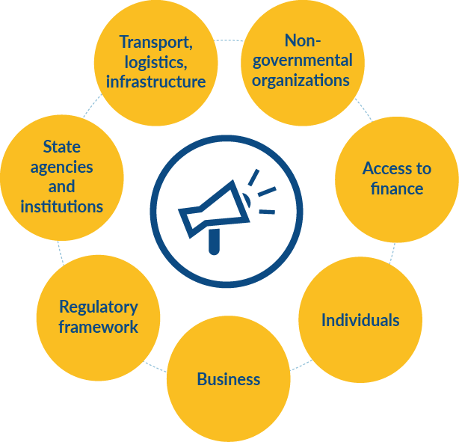
# Ukraine’s Export & Trade Support
Ecosystem
Chambers of Commerce and Industry
Federation of Employers of Ukraine
Entrepreneurship Support Centres, Ukrainian
Union of Industrialists and Entrepreneurs
Consortium “Enterprise Europe Network-Ukraine”
Export Promotion Office becomes
State Agency for Entrepreneurship
and Export Development in 2020
Government Office for
Coordination on European
and Euro-Atlantic Integration
Investment Promotion
Office (UkraineInvest)
Private Joint Stock Company
Export Credit Agency
Ukrainian Startup Fund
Cabinet of Ministers
of Ukraine
Ministry for Development
of Economy, Trade and
Agriculture of Ukraine
Ministry for Strategic
Industries of Ukraine
International Trade Council
Council of Exporters and Investors
under the Ministry of Foreign Affairs
of Ukraine

Slide 10
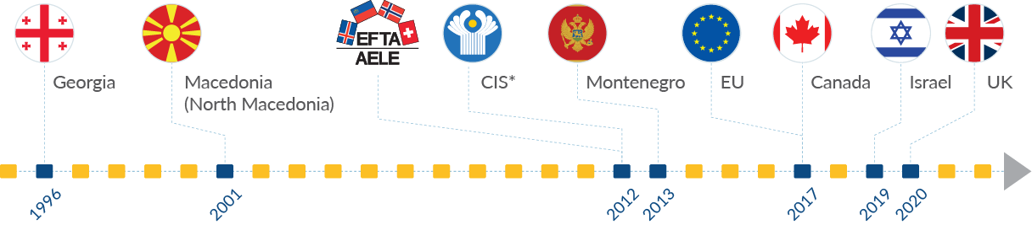
# Free Trade Agreements
* the FTZ does not include Russia

Slide 11

# Trade Facilitation by EPO
Database of Ukrainian companies seeking for cooperation with foreign partners
#UATRADECOVID19 that publishes relevant information on the most
recent changes in trade regulations, as well as official updates addressed
to exporters regarding the spread of COVID-19
Monthly digests on mechanical engineering, IT, confectionery, organic products and furniture sectors with information on sectors’ researches, educational seminars, partners’ search, as well as trade mission and exhibition announcements
Helpdesk for exporters to the EU with up-to-date information on the EU market requirements

Slide 12





# Ukraine’s Initiatives to Overcome
Covid-19 in Different Sectors of Economy
Agriculture
UAH 4 bln support to agrarians
land reform adopted
Services
access to finance by expanding current government lending programs
grant support for culture and education
Machinery
increase of tax rates was banned till 2021
procurement of machinery in mechanical engineering under the qualitative criteria
IT
flexibility in the employment of Ukrainians and foreigners
implementation of a favourable tax
policy minimal government intervention
Transport and infrastructure
sector modernization through reform of the joint-stock company “Ukrainian Railway”
and the state enterprise “Administration
of Seaports of Ukraine”
launch of river transport

Slide 13

# Ukraine NOW
Ukraine NOW is the global marketing campaign that was launched by the Ukrainian government in 2018. It aims at creating the brand of Ukraine globally to attract investments to the country and enhance tourism.

Slide 14
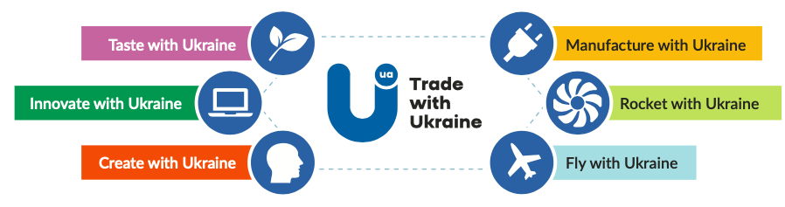

# TRADE WITH UKRAINE –
THE MAIN EXPORT SLOGAN
The export brand Trade with Ukraine is a part of the national brand Ukraine NOW. It aims at promoting Ukrainian goods and services on international markets.

Slide 15


# EXPO 2020 DUBAI
October 1, 2021 - March 31, 2022
The Organizing Committee of Expo 2020 in Dubai recognized Ukrainian pavilion among top-25

Slide 16



# Trade Fairs and International
Exhibitions during COVID-19 pandemic
Business for Smart Cities is a global event taking place in Kyiv that annually gathers the leaders of the region and international experts to define solutions to the problems of their cities and find the most appropriate partners to develop projects and services.
International exhibition of agricultural machinery and equipment InterAGRO. The majority of InterAGRO exhibitors are manufacturers of agricultural machinery and equipment, which contributes largely to the development and success of Ukrainian and global agribusiness.
The International Agricultural Exhibition “AGROEXPO" is in
top-10 of the largest agricultural exhibitions in Europe and is the largest exhibition in Ukraine, taking place in Kropyvnytskyi (geographical center of Ukraine).

Slide 17



# Trade Fairs and International
Exhibitions during COVID-19 pandemic
International Exhibition LAB ComplEX. The main event of laboratory industry of Ukraine within which comprises the whole range of equipment, technologies and specialized furniture, supplies as well as range of services for creation, equipping, modernization of all types and kinds of laboratories of various industries scientific-research field.
International transport and marine forum “TRANS EXPO ODESA 2020”
is an expanded business platform for cooperation between the transport and infrastructure sectors of Ukraine and the world business community, which aims to improve transport links between countries, ensure comprehensive innovative development of transport and infrastructure.
ElcomUkraine is the main trade show of energy, electrical engineering and energy efficiency in Ukraine.

Slide 18



# Trade Fairs and International
Exhibitions during COVID-19 pandemic
International Trade Show of Advertising REX annually gathers advertisers from all over the country and introduces novelties of advertising and souvenirs, printing, visual communications, advertising services and digital-marketing.
Franchising Trade Fair is in the TOP-5 of biggest European events. It is the only business platform for franchises purchase/sale, commercial property selection and everything necessary for a startup.
Industrial Cold Trade Show is the key event of refrigeration industry in Ukraine. The trade show presents: industrial refrigeration equipment, air conditioning and ventilation, measurement and control devices and automation, equipment and consumables for repairing, assembly, and servicing.

Slide 19
# Cross-sector Export Strategy
for Trade Information and Export
Promotion
Vision
Enabling Ukraine to tap into new markets by providing SMEs with a relevant and responsive ecosystem of international trade information and export promotion services

Slide 20





# Cross-sector Export Strategy for Trade
Information and Export Promotion
Strategic Objectives
Create an institutional framework, responding to the needs of the private sector and providing it with relevant, customer–oriented intelligence
Facilitate distribution of relevant information, enabling the private sector to access and interpret it
Effectively manage the TSIs network to make information collection, processing and dissemination accurate and transparent
Build an effective international network for delivering market intelligence and promote exporters abroad
Leverage international network of trade support institutions
Enhance presence of Ukrainian exporters abroad
Increase international recognition of Ukraine as a world–class exporter of quality, sustainably produced products
Promote export brand “Made in Ukraine”
Increase the number of sustainable export-oriented companies
Promote international recognition through FTAs

Slide 21
Thank you for attention!

