Slide 1






TRANSPORTATION AND
TRADE FACILITATION IN UKRAINE
2018-2020

Slide 2



# Trade facilitation components
Favorable public policy
Harmonization with EU standards
Qualified human capital
All transportation means are available
Developed infrastructure
Rapidly developing logistics

Slide 3
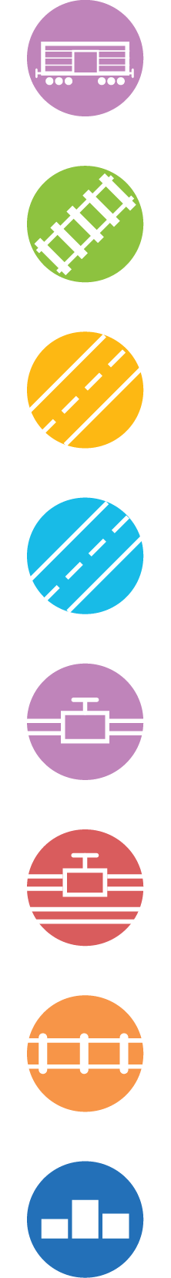
# Cross-sector Overview
24 336 600
passenger traffic in 2019
230
checkpoints
58
airlines
21*
international airports
13 sea ports
27 river ports
160 001 thousand tons
cargo turnover in 2019
230 million tons per year
cargo handling capacity
6,4% – GDP in 2018 by type of economic
activity “Transport, warehousing, postal
and courier activities”
28.6 million tons of grain
cargo transported by Ukrzaliznytsia
19 800 km total length of
Ukrainian railway networks
8 200 km total length of
international routes in Ukraine
4 800 km total length
of national routes
36 700 km total length of gas pipelines
152 100 km total length of gas
distribution networks
4 500 km length of the main oil and gas pipeline
Ranked 66th among 160 countries by
World Bank Logistics Performance Index (LPI) 2018
* temporary occupied territories and
Crimea exclusive

Slide 4
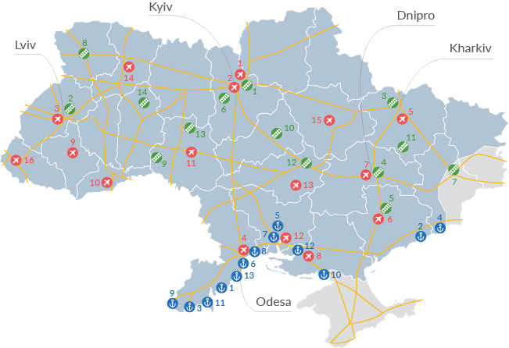
# Cross-sector Overview
Major international airports
Boryspil International Airport
Kyiv International Airport
Lviv International Airport
Odesa International Airport
Kharkiv International Airport
Zaporizhzhia International Airport
Dnipropetrovsk International Airport
Kherson International Airport
Ivano-Frankivsk International Airport
Chernivtsi International Airport
Vinnytsia International Airport
Mykolaiv International Airport
Kryvyi Rih International Airport
Rivne International Airport
Poltava Airport
Uzhhorod International Airport
1
2
3
4
5
6
7
8
9
10
11
12
13
14
15
16
* temporary occupied
territories and Crimea
exclusive
Main railroad interconnection stations
Kyiv
Lviv
Kharkiv
Dnipro
Zaporizhzhia
Fastiv
Debaltseve
Kovel
Zhmerynka
Network of trunk roads
M-highways
Smila
Lozova
Znamyanka
Koziatyn
Shepetivka
1
2
3
4
5
6
7
8
9
10
11
12
13
14
Sea ports
Bilhorod-Dnistrovskyi Sea Port
Berdyansk Commercial Sea Port
Izmail Sea Port
Mariupol Commercial Sea Port
Mykolaiv Sea Port
6
7
8
9
10
11
12
13
Odesa Sea Port
Specialized Sea Port Olvia
Pivdennyi Sea Port
Reni Sea Port
Skadovsk Sea Port
Ust-Dunaisk Sea Port
Kherson Sea Port
Chornomorsk Sea Port
1
2
3
4
5

Slide 5

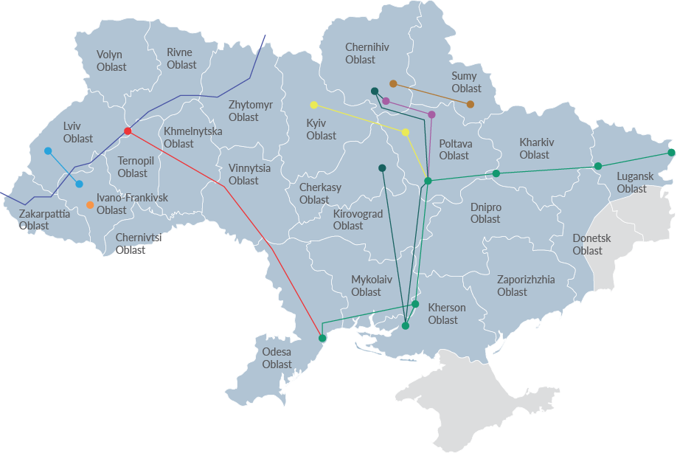

# Cross-sector Overview
Major oil and gas pipeline
Dolyna – Drohobych
Bytkiv – Nadvirna
(within Ivano-Frankivsk Oblast)
Kachanivka – Okhtyrka
Hnidyntsi – Pryluky –
Kremenchuk – Kherson,
Kremenchuk – Cherkasy
Samara – Lysychansk – Kremenchuk – Kherson – Odesa
The Druzhba pipeline is the world's longest oil and gas pipeline and one of the biggest oil pipeline networks in
the world. It carries oil and gas from Russia through the territory of the western regions of Ukraine (Volyn, Lviv
and Zakarpattia Oblasts) to Belarus and Europe
Kremenchuk – Lubny – Kyiv
Hnidyntsi – Rozbyshivka – Kremenchuk
Odesa – Brody
* temporary occupied
territories and Crimea
exclusive

Slide 6









# Trade facilitations efforts
Customs reform (single window, e-cabinet launched; automated customs procedures introduced; single treasury account for customs duties introduced)
Reform of State Service of Ukraine on Food Safety and Consumers Protection
Concession projects
State policy addressed at elimination of non-tariff barriers
Promising business deregulation initiatives
Harmonization of trade rules with EU acquis
Membership in reputable international trade organizations (WTO, EU AA, other FTA agreement; agreements in progress like ACAA, etc.)
State digitalization program
National transport strategy of Ukraine 2030 adopted

Slide 7

# Why Ukraine?
Competitive geographic position
Implementation of key
TFA provisions
Digitalization of customs procedures
Full transport cycle
Pipeline facilities
Skilled personnel
Paperless trade
Dynamic progress in trade facilitation efforts
Consultancy in trade area is easily
accessible and affordable
Diverse transport infrastructure
TRACECA
Historically convenient sea routes
Trade in services
Diverse system of free trade agreements

Slide 8
# Cross-sector Export Strategy for
Transportation and Trade Facilitation
Vision
Creating a favorable regulatory and managerial environment to ensure the growth of Ukraine's export potential and improve business conditions while enhancing competitiveness and efficiency of the national economy

Slide 9





# Cross-sector Export Strategy for
Transportation and Trade Facilitation
Strategic Objectives
Strengthen interagency coordination and ensure strategic development in international trade
Enhance cooperation in the field of customs information exchange with EU Member States
Implement strategic reforming of international trade
Create conditions for
efficient trade-related services for companies to accelerate and reduce the cost of trade operations
Increase awareness of trade rules for businesses
Improve the quality of business services in commercial infrastructure
Improve the regulatory environment in international trade
Improve legislation to facilitate trade and export
Create conditions to foster export potential of enterprises and expand trade

Slide 10
Thank you for attention!

