Slide 1






SKILLS DEVELOPMENT
IN UKRAINE
2018-2020

Slide 2



# Skills Development Ecosystem
Education
(New Ukrainian School,
HE, VET, private education)
Business
(corporate schools and universities,
educational programs and trainings)
Lifelong education
(Centres of Excellence,
online courses
and webinars)
Social partners
Policy makers
Sector organisations
Clusters
Individuals

Slide 3

# Why Ukraine?
Fundamental
scientific
background
Developed
institutional
capacity
State
digitalization
program
Developed
legal
framework
Historically
strong
education
Qualified
human
capital
Creativity
Innovation
International and
EU standards

Slide 4


# Key Figures
1,44 mln
students at universities,
academies, institutes
333,6k graduates from universities,
academies, institutes in 2019
50,2k graduates from colleges
and technical schools
281
universities, academies, institutes
338
colleges and technical schools
Around 900 state-owned
VET providers
Around 2 000 private
VET providers
Around 20 private
business schools
100+ R&D centres
99% literacy
73% Ukraine’s labor force with
advanced education in 2018
75,3% Gross enrolment ratio,
tertiary education in 2018
Member of the PISA
Member of the Bologna Process
Member of the Torino Process

Slide 5


# Ukraine in Global Rankings
Ranked 45th among
139 countries by
Global Creativity Index
Ranked 45th among 131 countries by
Global Innovation Index 2020
23rd in Knowledge creation sub-index
32nd in Knowledge diffusion sub-index
45th in Knowledge impact sub-index
23rd in Education sub-index
32nd in Tertiary education sub-index
44th in R&D sub-index
23rd in Intangible assets sub-index
39th in Online creativity sub-index
Top-1000 in
QS World University
Rankings 2021
Regularly highly ranked
at the annual International
Mathematical Olympiad
Gradually improving in
the Doing Business ranking

Slide 6
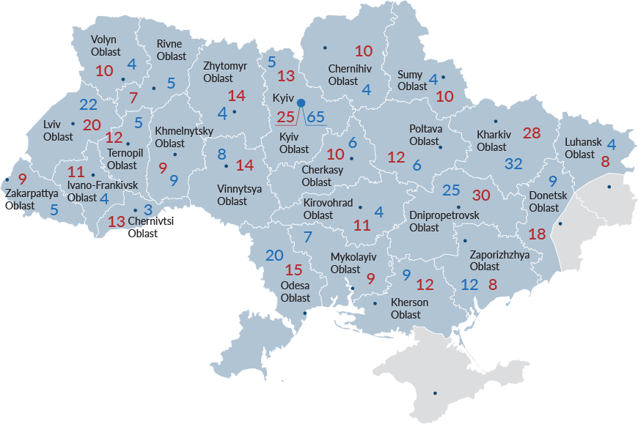
# Major HE and VET Institutions
Number of universities,
academies, institutes in 2019
Number of colleges and
technical schools in 2019

Slide 7
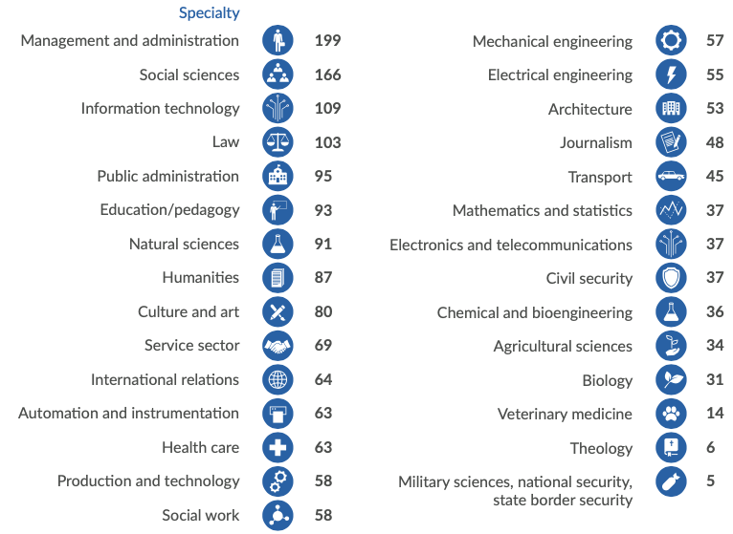
# Major HE and VET Institutions
266 HE offering master degree

Slide 8

# Top 10 Specialties 2020 by number of applications
42 379
43 791
46 844
47 038
50 841
62 676
Marketing
Psychology
Finance, banking and insurance
Software engineering
Economics
Pedagogy
Law
Management
Philology
Computer science
116 689
92 147
76 708
63 410

Slide 9

# Top 10 Most Popular HE Institutions
by number of applications
Taras Shevchenko National University of Kyiv
National Technical University of Ukraine “Igor Sikorsky Kyiv Polytechnic Institute”
Ivan Franko National University of Lviv
Lviv Polytechnic National University
Kyiv National University of Trade and Economics
National Aviation University
Kyiv National Economic University named after Vadym Hetman
V. N. Karazin Kharkiv National University
National Pedagogical Dragomanov University
National University of Life and Environmental Sciences of Ukraine

Slide 10






# Clusters and HE/VET Cooperation
Kyiv IT Cluster cooperates with National Technical University of Ukraine “Igor Sikorsky Kyiv Polytechnic Institute”, Kyiv Academic University, National University of Kyiv-Mohyla Academy, State University of Telecommunications, Kyiv National Economic University named after Vadym Hetman and European University
Lutsk IT Cluster cooperates with Lesya Ukrainka Eastern European National University, Lutsk National Technical University and ITEA courses
Precarpathian Eco-Energy Cluster cooperates with Vasyl Stefanyk Precarpathian National University and Ivano-Frankivsk National Technical University of Oil and Gas
Ivano-Frankivsk IT Cluster cooperates with Ivano-Frankivsk National Technical University of Oil and Gas and Vasyl Stefanyk Precarpathian National University
Cherkasy IT Cluster cooperates with Cherkasy State Business College
Chernihiv IT Cluster cooperates with Chernihiv Polytechnic National University

Slide 11





# Clusters and HE/VET Cooperation
Vinnytsia IT Cluster cooperates with Vasyl’ Stus Donetsk National University, Vinnytsia National Technical University, Vinnytsia State Pedagogical University, Vinnytsia Technical College, Beetroot Academy and Rainbow School
Lviv IT Cluster closely cooperates with Ivan Franko National University of Lviv, Lviv Polytechnic National University, and in 2017–2019, cluster worked on the construction of innovational student labs
Lviv Publishing and Printing Cluster cooperates with Stavropigion Higher Vocational School of Lviv and Ukrainian Academy of Printing
IT Cluster Konotop cooperates with Classical Vocational College of Sumy State University, Konotop Institute of Sumy State University and Konotop Industrial and Pedagogical Professional College of Sumy State University
Kharkiv IT Cluster cooperates with National Technical University “Kharkiv Polytechnic Institute”, V. N. Karazin Kharkiv National University and Kharkiv National University of Radio Electronics
In 2019, 950 Ukrainian organizations carried out R&D work,
of which 43.1% refer to the public sector; 42.9% – to business; 14% – to HE.

Slide 12






# Skills Development in Ukrainian Companies
is a corporate learning hub that equips associates with in-demand managerial and leadership competencies, plus IT skills
provides ongoing self-growth opportunities for specialists, students and
IT enthusiasts
provides long term programs and
corporate trainings
from Nova Poshta provides educational opportunities for SMEs in the regions of Ukraine to gain key knowledge for the development of their business
from Ukrposhta launches webinars in the issues of exports and business globalisation to support SMEs
from Kyivstar trains its students to work with
Big Data and apply the acquired knowledge on real business projects

Slide 13
# Cross-sector Export Strategy Skills Development
Vision
Development of highly skilled workforce supported by initial and continuous industry-relevant learning programs leading
to export competitiveness and growth

Slide 14





# Cross-sector Export Strategy Skills Development
Strategic Objectives
Facilitate entrepreneurial spirit among the youth and help SMEs develop managerial skills
Provide high-quality learning opportunities for new and existing export businesses
Ingrain training programs into the larger entrepreneurship ecosystem
Enhance collaboration between the industry, HE and VET
Align educational offering to business needs, in particular SMEs
Collect consistent, up-to-date labor market information to meet needs of the priority sectors
Provide market-oriented information on labor offering and needs to meet aspirations of young people and track jobs in high demand by export sectors
Establish a national platform for communication between government and business aimed at collaboration, planning and development of skills necessary to enhance exports and competitiveness
Develop a national cluster program for collaboration and development of skills necessary to facilitate export growth and competitiveness
Ensure economic welfare by fostering innovations, soft skills, management and technical skills through increasing the variety of high-quality learning strategies and learning activities
Ensure that flexible and diverse HE and VET offerings are available, which will help develop a vibrant and responsive HE and VET ecosystem
Develop a knowledge base of cluster initiatives
Launch a cluster development program

Slide 15
Thank you for attention!

